Slide 1
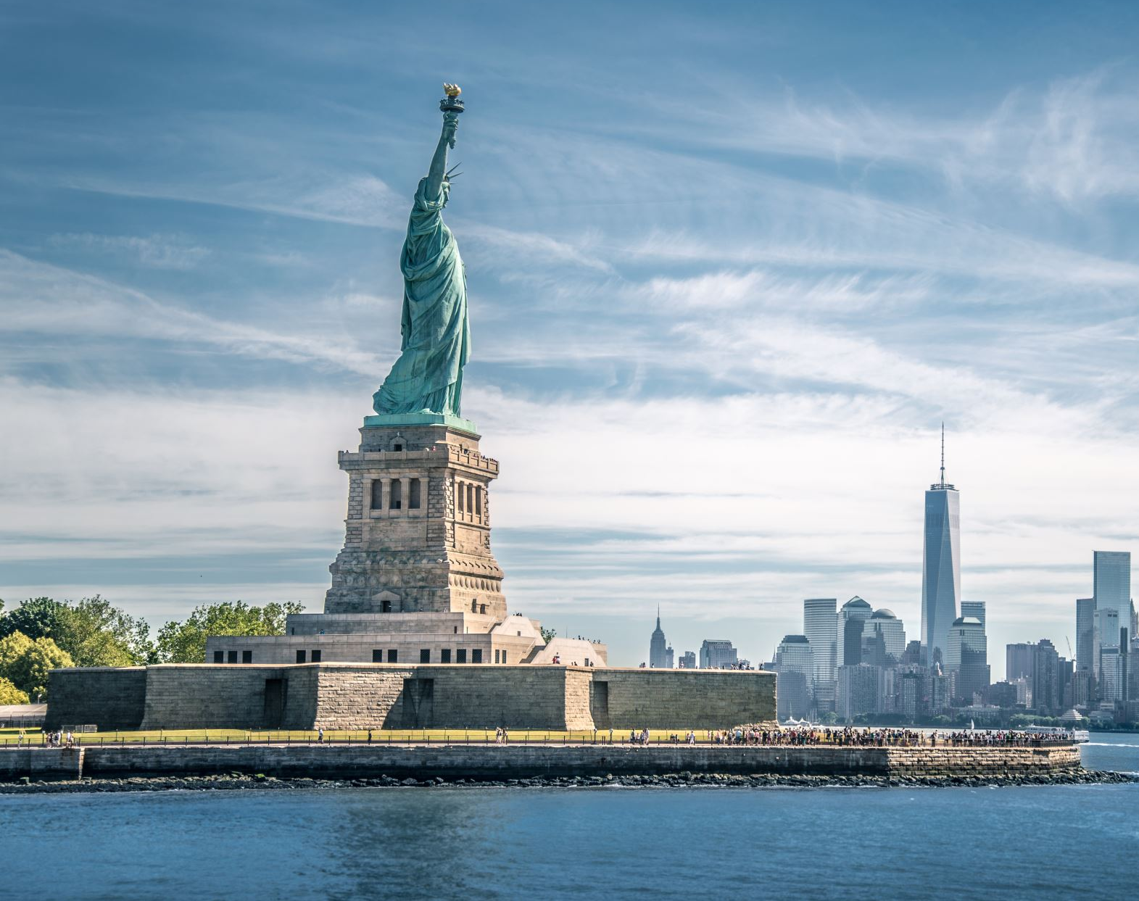
Immigrants Talents & Skills
FILLING THE GAP

Slide 2
Immigrants Contributions to the USA labor Market
Immigration is a hot topic in today’s political conversation in the USA. People have strong opinions about immigrants and their contribution or lack thereof to the USA economy and the labor force.
The motivation for my research is to dispel the myths from the facts based on data. My research focuses on the skills, talents and education of the most recent wave of immigrants, the last 8 years of available data (2000 – 2018) and how they relate to the current USA labor market by contrasting my findings with other reputable research.
The data used for my research is a sample of the American Community Survey which is part of the USA Census Bureau ( https://www.census.gov/programs-surveys/acs). U.S Census Data for Social, Economic and Health Research. I downloaded the data from Integrated Public Use Microdata Series (IPUMS-USA, University of Minnesota, www.ipums.org).

Slide 3




Technologies Used
Python
Data Exploration
Visualizations and Dashboard

Slide 4
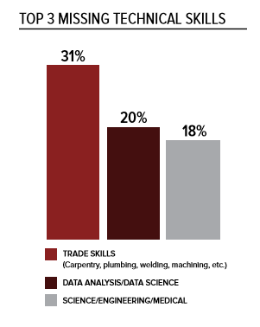
Research by the Society for Human Resource Management (SHRM) world’s largest HR association found that:
“7 million jobs were open in December 2018, but only 6.3 million unemployed people were looking for work. As the country nears full employment, businesses face an even greater talent shortage that will have a stifling impact on the economy and global innovation. “
SHRM Skills Gap Research

Slide 5
Important Take A ways

Slide 6
US Presidents Quotes on Immigrants
“Everywhere immigrants have enriched and strengthened the fabric of American life.” John F. Kennedy
“The land flourished because it was fed from so many sources–because it was nourished by so many cultures and traditions and peoples. ”Lyndon B. Johnson
“More than another nation on Earth, America has constantly drawn strength and spirit from wave after wave of immigrants. In each generation, they have proved to be the most restless, the most adventurous, the most innovative, the most industrious of people. Bearing different memories, honoring different heritages, they have strengthened our economy, enriched our culture, renewed our promise of freedom and opportunity for all….” Bill Clinton

